Slide 1
Cross-Lingual Natural Language Processing
Ali Reda

Slide 2
Introduction
Cross-Lingual NLP involves developing algorithms for machines to comprehend, process, and generate text in multiple languages.
For example, a cross-lingual sentiment analysis model helps businesses understand customer feedback globally.

Slide 3
Challenges in Multilingual NLP
Traditional NLP models struggle with language variations; for instance, sentiment analysis on English tweets may not perform well on Swahili tweets.
Data scarcity is evident when considering a sentiment analysis model trained on English, facing challenges when applied to languages with fewer labeled datasets like Swahili.

Slide 4
Motivation for Cross-Lingual NLP
Cross-Lingual NLP addresses the need for machines to understand diverse languages.
For instance, a translation model can help break language barriers, translating legal documents.

Slide 5
Methods for Cross-Lingual NLP
Transfer learning involves pre-training models, and an example is pre-training a sentiment analysis model on English and fine-tuning it for French.
Multilingual embeddings capture semantic relationships, aiding in tasks like cross-lingual information retrieval and sentiment analysis.

Slide 6
Cross-Lingual Embeddings
Word embeddings represent words as vectors, and cross-lingual embeddings ensure similar vector representations for semantically similar words.
For example, the word "amigo" in Spanish and "friend" in English would have similar vector representations.

Slide 7
Cross-Lingual Transfer Learning
Transfer learning leverages knowledge from one language to improve performance in another.
Consider a sentiment analysis model pre-trained on English reviews and fine-tuned for sentiment analysis in French with fewer labeled data.

Slide 8
Code-Switching in Cross-Lingual NLP
Code-switching involves alternating between languages in a sentence.
A social media post seamlessly switching between English and Hindi exemplifies code-switching challenges and opportunities.

Slide 9
Cross-Lingual Applications
A news summarization system processes articles in multiple languages for a global audience.
Consider a cross-lingual chatbot assisting users worldwide, understanding and responding in their preferred language.

Slide 10
Cross-Lingual Evaluation
Use precision, recall, F1-score, and BLEU score for evaluation.
Challenges arise in evaluating tasks with no standardized metrics, making cross-lingual evaluation complex.

Slide 11
Industry Adoption and Trends
Industries adopt Cross-Lingual NLP for global marketing; a translation model can adapt marketing strategies for diverse linguistic audiences.
Emerging trends include more effective domain adaptation, improved low-resource language processing, and evolving evaluation metrics.

Slide 12
Conclusion
Cross-Lingual NLP is crucial in breaking down linguistic barriers, facilitating seamless communication, and fostering a truly global exchange of ideas.

Slide 13
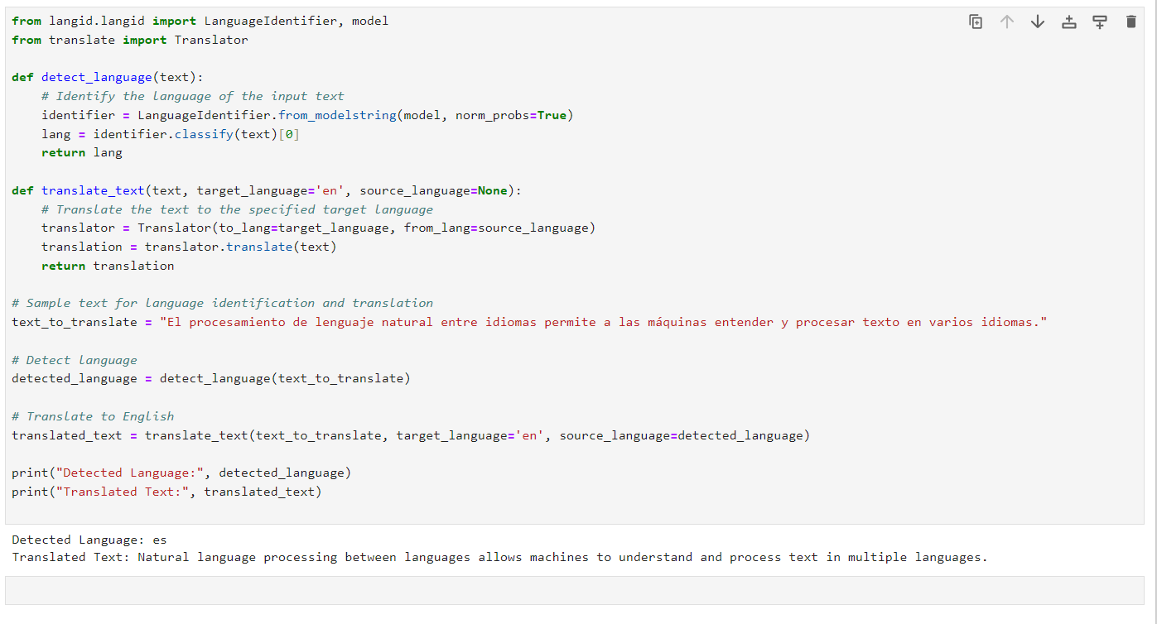

Slide 14
Thank you

